Slide 1
4th Nigerian national mission congress
THE ROLE OF THE MEDIA IN EVANGELIZATION
Bishop Emmanuel Ade Badejo
Bishop of Oyo Diocese

Slide 2
THE role OF THE MEDIA lies BETWEEN THE MASS AND THE MASSES
GO THE MASS IS ENDED, CHILDREN OF THE LORD
TAKE HIS WORD TO OTHERS, AS YOU HEARD IT SPOKEN TO YOU
GO THE MASS IS ENDED, TELL THEM OF HIS LOVE
THE LORD IS GOOD, THE LORD IS KIND AD HE LOVES EVERYONE

Slide 3
THE ROLE OF THE MEDIA IN EVANGELIZATION: OPPORTUNITIES AND CHALLENGES
THE CONTENT OF EVANGELIZATION REMAINS THE SAME BUT THE PROCESS MUST BE MEDIATED AND REGULARLY UPDATED

Slide 4
LAY PROFESSIONALS AND PRACTITIONERS CONSTITUTE THE BIGGEST OPPORTUNITY AND CHALLENGE
SIGNIS International Catholic Media Professionals with huge reach and facilities. Fr Walter Ihejirika is now the President for Africa. Last Congress was in Ethiopia
CAMPAN Catholic Media Practitioners/Professionals Association of Nigeria uniting Church Media with the Secular… just met in Warri Diocese
CAEAN Catholic Artistes and Entertainers Association of Nigeria for actors , actresses singers and entertainers. Not meant for comedy, has achieved great things in the past.

Slide 5
The challenge
They need formation
They need accompaniment
Sometimes they need understanding
Sometimes they need money

Slide 6
THE PEOPLE OF TODAY REMAIN THE MOST VALUABLE ASSET OF MEDIA FOR EVANGELIZATION IN OUR DAY.
AS THE TIMES CHANGE SO DO PEOPLE AND HUMAN BEINGS ARE THE MOST ADAPTABLE
AJA IWOYI…

Slide 7
ST PAUL WAS THE PIONEER IN SCRIPTURE
HE WROTE LETTERS TO EVANGELIZE EVEN PLACES HE COULD NOT BE IN A PARTICULAR TIME. CAN ANYONE DOUBT THE IMPACT OF HIS EFFORT?

Slide 8
EVERYONE MUST HEED THE MANDATE OF JESUS TO MAKE DISCIPLES OF ALL NATIONS EVERYBODY MUST DO SOMETHING: HERE IN NO PARTICLUAR ORDER… priests RELIGIOUS HOLY CHILDHOOD YOUTH WOMEN CMO LAITY COUNCIL COMPONENTS CHURCH SOCIETIES, SODALITIES, PROFESSIONAL GROUPS

Slide 9
Co-responsibility, “ka sowo po, ko le da” you lift, I lift

Slide 10
ENCOURAGING WORDS
From Pope Paul VI: Evangelii Nuntiandi, 1976
“In an age which is characterised by the mass media we must not fail to avail of the media for the first proclamation of the message for catechetical instruction and for a deeper study of the faith…”

Slide 11
EVANGELII NUNTIANDI. n 45
“The Church would feel guilty before the Lord if she did not utilize these powerful means that human skill is daily rendering more perfect. It is through them that she proclaims ‘from the housetops’ the message of which she is the depositary. In them she finds a modern and effective version of the pulpit. Thanks to them she succeeds in speaking to the multitudes”

Slide 12
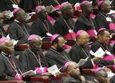
From Ecclesia in Africa
Today, the Church has at her disposal a variety of means of social communication, traditional, as well as modern. It is her duty to make the best possible use of them in order to spread the message of salvation.

Slide 13
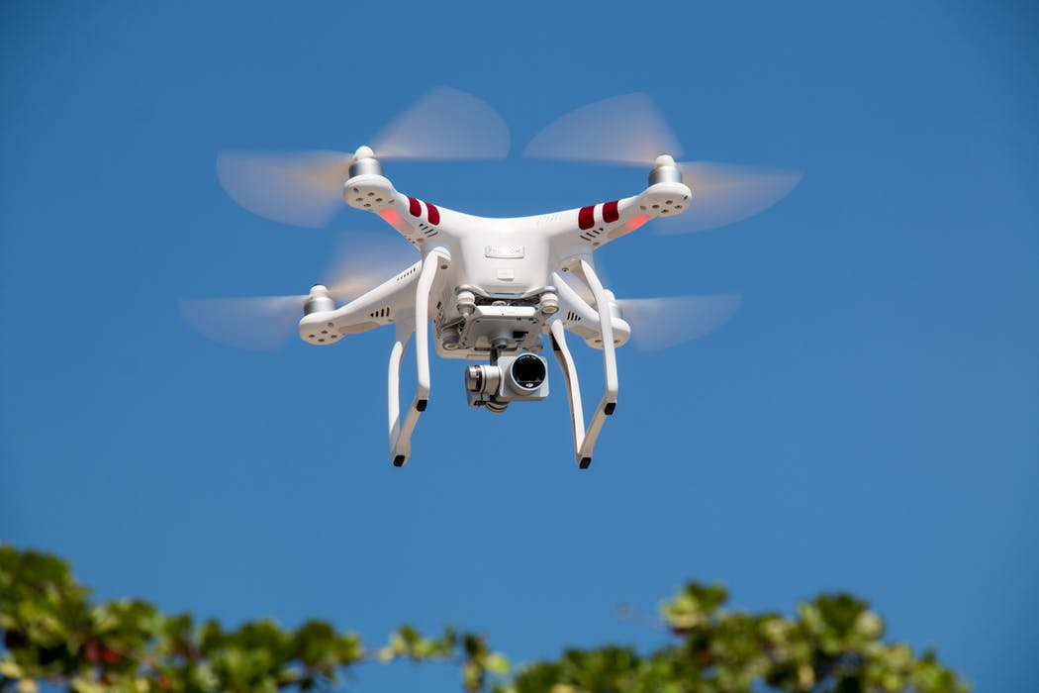
THEREFORE, we NEED EVERYBODY TO USE EVERYTHING FOR SPREADING THE GOSPEL

Slide 14
ENGAGE THE NEW CULTURE AS A BIG OPPORTUNITY TO EVANGELIZE

Slide 15
ADOPT AND ADAPT
EXISTING MESSAGES/
STYLES

Slide 16
ADOPT AND ADAPT youth energy
KNOW JESUS KNOW LIFE (B. MARLEY)
THE ANSWER IS FOUND IN JESUS CHRIST (B. DYLAN)
I WANNA LOVE YOU (B. MARLEY)
EXISTING FUNCTIONING MESSAGES/
STYLES

Slide 17
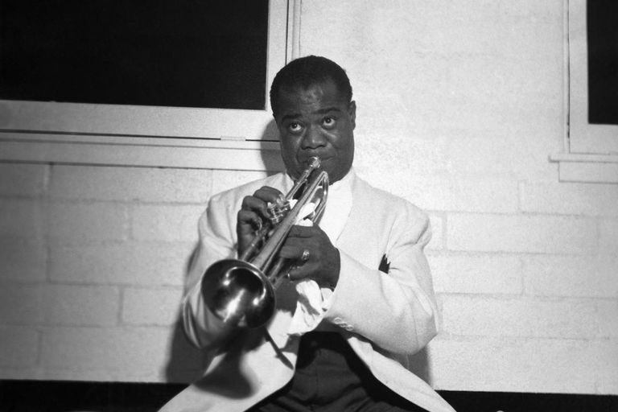
Turn gospel and catechism into songs, SHARING, RIDDLES, slogans, DRAMA…

Slide 18
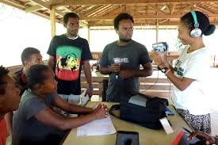
ADOPT NOT JUST THE DIGITAL METHODS BUT ALSO THE “PARTICIPATORY, belonging” CULTURE

Slide 19
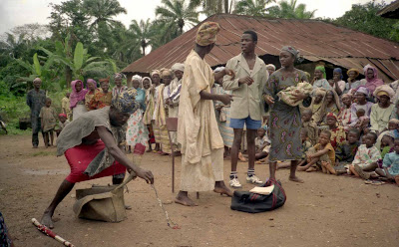
With Drama

Slide 20
AND DANCE

Slide 21
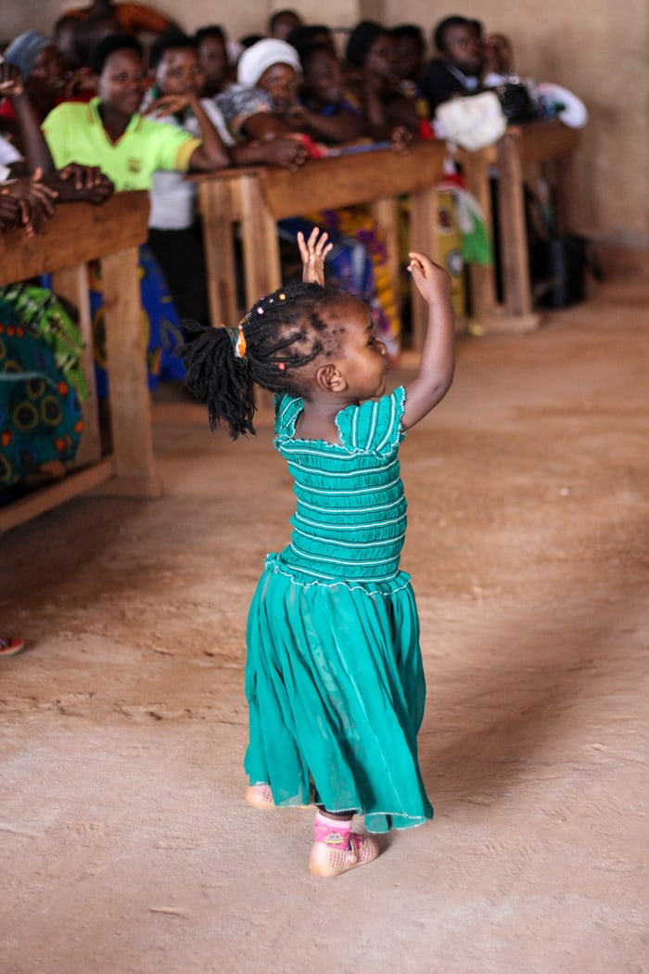

Slide 22
First, Get PEOPLE’S attention and then teach them what you will

Slide 23
Get the projector rolling with FAITH MATERIALS

Slide 24
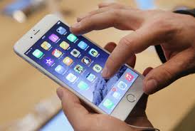
REV. Fr .Prof Joseph FANIRAN (PROF OF COMMUNICATIONS CESAAC, PORT HARCOURT) SAID:
“INDIVIDUALS HAVE TO BE TRAINED TO EMPLOY THEIR PERSONAL CONTACTS AND TALENTS IN THE SERVICE OF THE GOSPEL…THE PAINTERS, COMPOSERS, CARVERS: CELEBRATE THEIR FAITH IN JESUS THROUGH THEIR TALENTS”

Slide 25
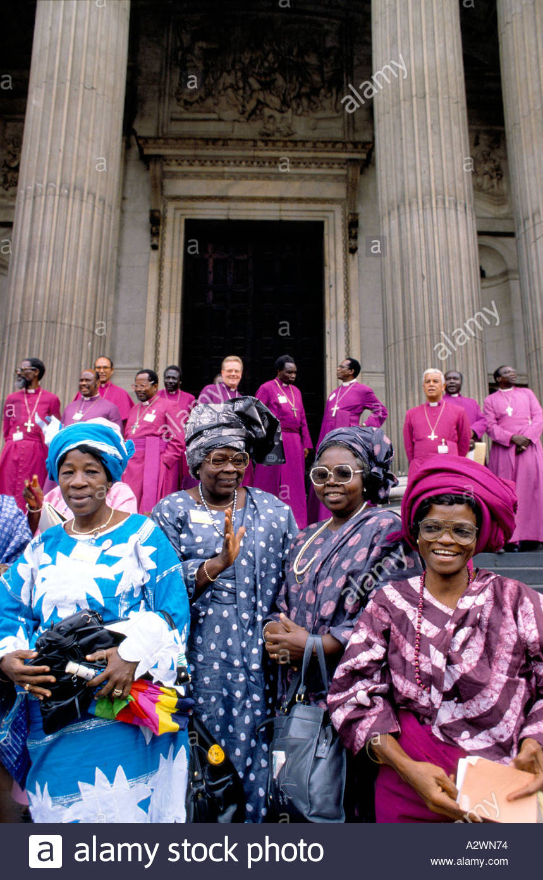
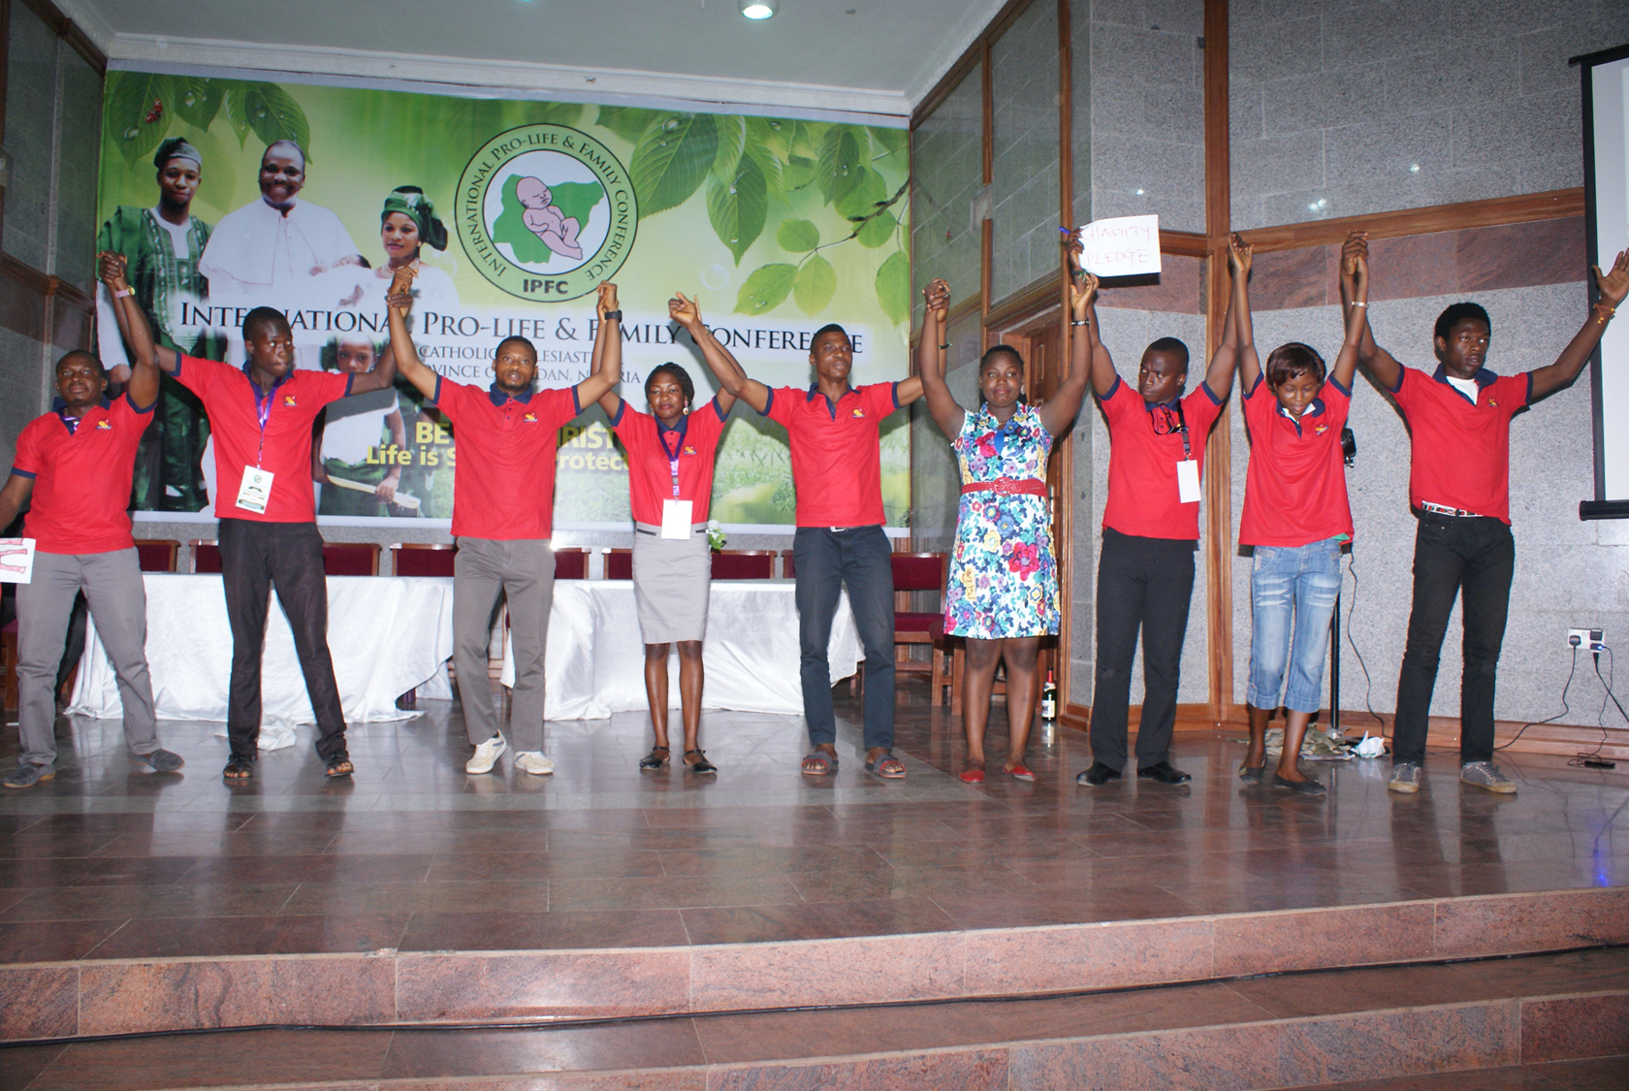
Women and youth are key AGENTS

Slide 26
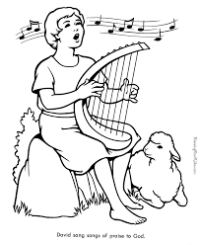
BUT WE ALL NEED THE ZEAL AND ENTHUSIASM FOR THE TASK
Woe to me if I do not preach (1Cor 9:16)
Always be prepared to witness. (1Pet 3:15)
You are the light of the world.(Matt. 5:14)

Slide 27
REMEMBER…I PHONES, IPAD, IPOD …
ARE REPLACING EVEN THE TELEVISION AS THE MOST POPULAR MEANS OPEN TO USE FOR EVANGELIZATION AND CATECHESIS. SO WE MUST CONSTANTLY UPDATE
PRIESTS ARE THUS CHALLENGED TO PROCLAIM THE GOSPEL BY EMPLOYING THE LATEST GENERATION OF AUDIO VISUAL RESOURCES – IMAGES, VIDEOS, ANIMATED FEATURES, BLOGS, WEB SITES – WHICH ALONGSIDE TRADITIONAL MEANS CAN OPEN UP BROAD VISTAS FOR DIALOGUE, EVANGELIZATION AND CATECHESIS
POPE BENEDICT XVI: WDC 2010
SOCIAL NETWORKS ON THE INTERNET
TWITTER, FACEBOOK WHATSAPP TEXTING , IM

Slide 28
WE SHOULD PUT OUR MONEY WHERE OUR MOUTH IS:
FOR FACILITIES
FOR RESOURCESS
FOR SOFTWARE
FOR EQUIPMENT
FOR SERVICES
FOR FORMATION
FOR PRODUCTION
FOR REMUNERATION
FOR RECRUITMENT

Slide 29
THANK YOU FOR your KIND ATTENTION
,
GOD BLESS YOU

